Slide 1

NIE INSTITUTE OF TECHNOLOGY
Department OF INFORMATION SCIENCE AND ENGINEERING
Real-time Fake currency detection using cnn
PRESENTED BY:
NAVANEETHA K R - 4NN18IS024
NIRMAL KUMAR B - 4NN18IS027
SUMITH AMIN N - 4NN18IS049
TUSHITHA ARUN - 4NN18IS051
UNDER THE GUIDANCE OF:
Mrs. Shruthi B. S

Slide 2
contents
1
Abstract
Introduction
Objective
System Requirements
Identification of problem
Literature survey
Use Case Diagram
Flow Chart
CNN Architecture
Proposed system
Methodology
Implementation
Outcome
References

Slide 3
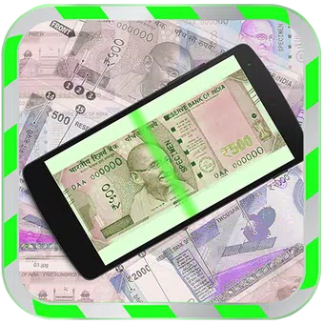
Abstract
2
Fake Currency has always been an issue which has created a lot of problems in the market.
There are machines present at banks and other commercial areas to check the authenticity of the currencies. But a common man does not have access to such systems and hence a need for a software to detect fake currency arises, which can be used by common people.
This proposed system uses Image Processing to detect whether the currency is genuine or counterfeit.

Slide 4
Introduction
3
The identification of currency depends on the characteristics of currency notes of a particular country. Due to use for a long time, currency notes may be contaminated by noises.
To Identify whether the currency is authentic or not there are many features. Although it may not be practically possible to accurately identify a counterfeit in a paper currency which can only be identified by an intelligent machine.
The approach presented in this paper is based upon physical appearance of the Indian currency. It consists of the steps, which are performed using suitable methods.
Image processing algorithms with CNN are being adopted to extract the features.

Slide 5
Objectives
4
Designing an algorithm for identifying currency value.
Designing a feature extraction and recognition.
Designing an algorithm for verifying authenticity of the currency.
Designing an User-Friendly Android Application.

Slide 6
System Requirements
5
Software Requirements
Hardware Requirements
Numpy 1.14.1
tensorflow 1.6.0
Matplotlib 1.2.1
Google collab/Jupyter Notebook
Android studio
Amazon EC2
Flask
HDD: 10GB or more
RAM: 4GB or more
Processor: Dual core or above

Slide 7
Identification of Problem
6
Motion blur problem
Noise imposed by image capture instrument
Less efficient feature extraction technique
Colour based recognition

Slide 8
Literature survey
7
Paper 1 : Indian Fake Currency Detection Using Computer Vision(May 2020)
Description:
In the project we proposed a novel approach for the detection and classification of duplication in currency note using ORB (Oriented FAST and Rotated BRIEF) and Brute-Force matcher in OpenCV.
Advantages:
Faster method to identify Notes and its authenticity in OpenCV.
Drawbacks:
It is an desktop App based on OpenCV.
Lesser accuracy

Slide 9
8
Paper 2 : Fake Currency Detection Using Image Processing (Apr 2019)
Description:
This proposed system uses Image Processing to detect whether the currency is genuine or counterfeit. The system is designed completely using Python programming language. It consists of the steps such as grayscale conversion, edge detection, segmentation, etc. which are performed using suitable methods.
Advantages:
Number of feature extraction are high.
It also shows where the differences are in the currencies instead of simply displaying the result.
Drawbacks:
Not suitable for real-time experience.
The model is performed only in MATLAB.

Slide 10
Paper – 3: An Artificial Neural Networks Based Fake Currency Detection System
Description:
This technique consolidates of different cases, quickly advancement of various improvement applications in different assignments. Distinctive models are settled on different example acknowledgement strategies can be assessed into various classes given various cases selected to information and characterization investigation.
Advantages:
The process contains techniques such as image pre-processing, grey scale conversion, edge detection, segmentation, feature extraction and comparison of feature.
Drawbacks:
Cost of Microcontroller and strength inactivity.
Not portable and not user-friendly.
9

Slide 11
Paper 4 : Feature Extraction and Identification of Indian Currency Notes (2015)
Description:
They proposed an Indian currency recognition system which extracts the most prominent features of an Indian banknote viz. central numeral representing denomination, the national emblem, Identification mark for the visually impaired and the color band. Specific algorithms, targeted and optimized to recognize these particular features are then employed for their detection and recognition.
Advantages:
Accurate Colour recognition
Higher testing Accuracy
Drawbacks :
Model made for old Indian currency denomination.
Not ideal for app.
10

Slide 12
11
Paper 5:Detection of Fake Currency using Image Processing (Dec 2019)
Description:
The approach presented in this paper is based upon physical appearance of the Indian currency. Image processing algorithms have been adopted to extract the features such as security thread, intaglio printing (RBI logo) and identification mark, which have been adopted as security features of Indian currency. Hence, we propose a more user friendly and portable solution to this problem in form of an mobile app coupled with cloud storage.
Advantages:
SVM Algorithm
Using cloud storage for execution of image-processing.
Drawbacks:
Not Real-time approach
Color faded notes will be considered as fake by this model.

Slide 13
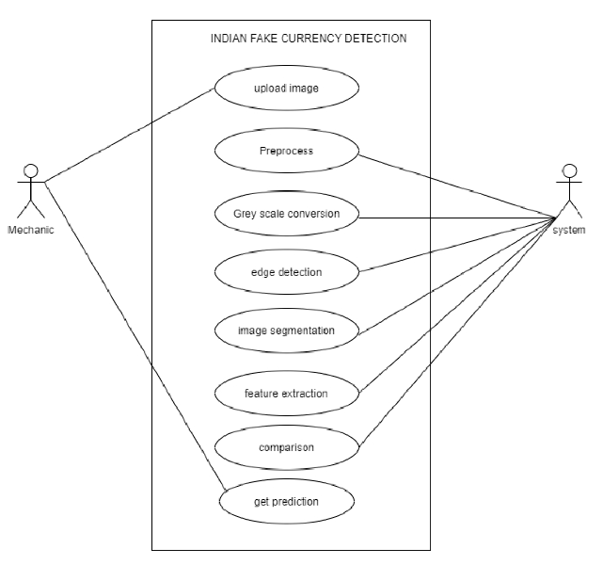
Use Case Diagram
12

Slide 14
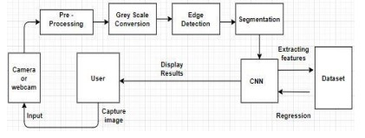
FLOWCHART
13

Slide 15
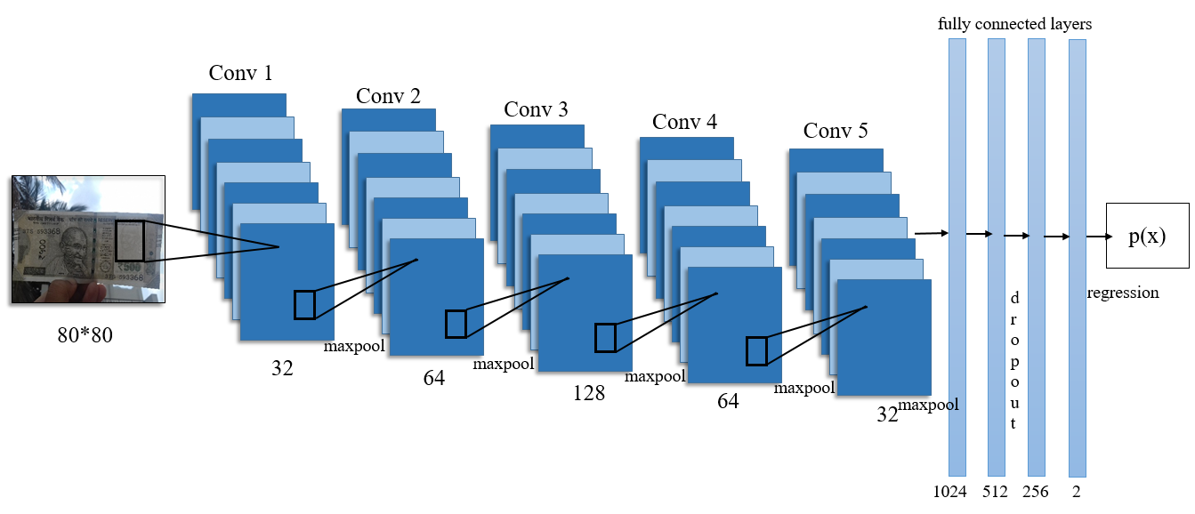
CNN Architecture: Our Custom Model
14

Slide 16
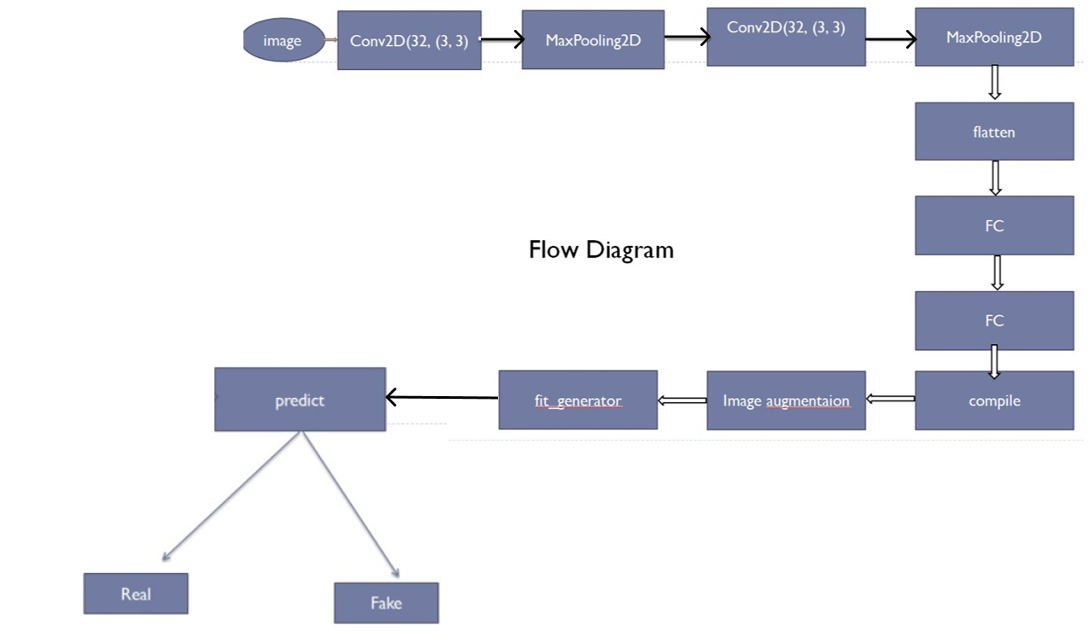
CNN Flowchart
15

Slide 17
Proposed System
16
Our proposed system will be capable of performing real time detection of fake currency as we are using cloud storage for execution of our image processing logic simultaneously reducing the size of an app which plays crucial role for daily users.
The data set was made by collecting high-quality images of both original and fake currency. The images will be converted into a dimension of 224 x 224 pixels.
Our model proposes a binary image classification task with two classes-fake or real.
The Deep CNN model we have built helps us detect the counterfeit note.

Slide 18
Methodology
17
The system proposed here work on the image of Indian currency note acquired by a digital camera. The method which is applied here is as follows
Acquisition of image of Indian currency note by simple digital camera or scanner.
Image acquired is RGB image and converted to Grayscale image.
Edge detection of whole gray scale image.
Now Indian currency features of the paper currency both observe and reverse will be cropped and segmented.
After segmentation, feature of Indian currency note are extracted.
CNN match that database features with test images note then the test note is said as original otherwise fake.

Slide 19

Implementation
18
FrontEnd :
User friendly application is created using android studio which,
- Should capture the image as input.
- Should display the result.
BackEnd :
CNN model is created to classify the currency notes whether it is fake or real.
Then model is deployed in Amazon EC2 after creating an instance in it.
This model will be running all the time.

Slide 20
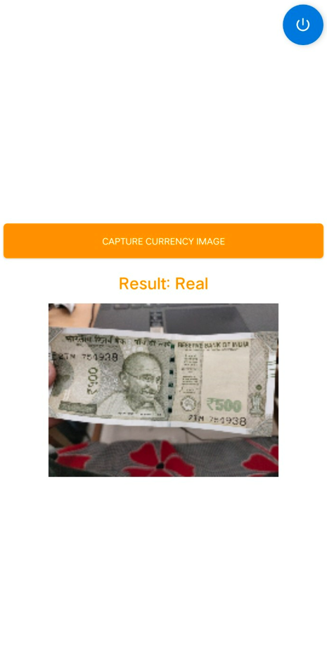
Outcome
19
The image is uploaded in real time so that the result can be computed instantly.
Image which is captured through application is fed to the CNN model and the predicted results are pushed back into the application.
After the results have been predicted by the model and uploaded the android application fetches the results instantly and the results will be displayed on the app.

Slide 21
references
20
https://www.ijert.org/detection-of-fake-currency-using-image-processing
https://ieeexplore.ieee.org/document/8994968
Fake Currency Detection Using Image Processing (Apr 2019)
Indian Fake Currency Detection Using Computer Vision(May 2020)
Feature Extraction and Identification of Indian Currency Notes (2015)
Detection of Fake Currency using Image Processing (Dec 2019)

Slide 22
Thank you

